Slide 1
RNA-seq Workshop (Using DESeq2) ~ Blueberry Breeding Lab ~
Gabriel O. Matsumoto
Edson de Andrade Silva, Ph.D

Slide 2
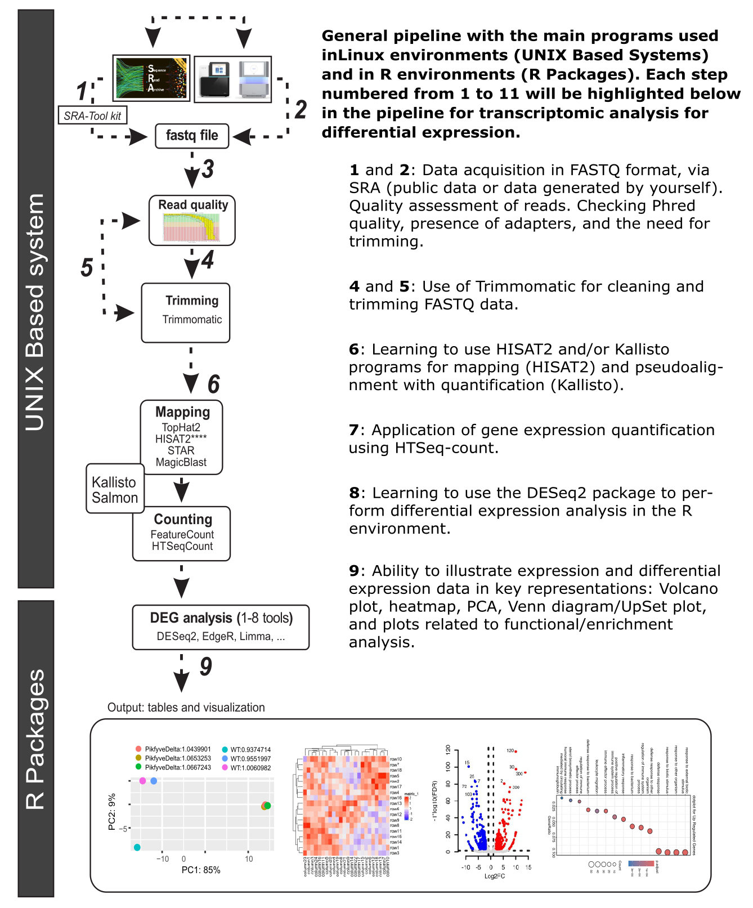
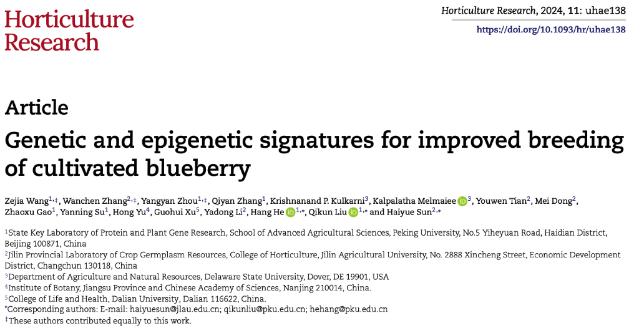
Experimental Design
Leaves from the ‘sharpblue’, ‘Draper’, and V. dar-
rowii accessions
Collected at five different stages;
SG, MG, LG, PP, FP;
Each replicate containing six fruits;
Total RNA from fruits from the strain
using the Trizol reagent;
Novogene (Tianjin, China) for library
preparation and deep sequencing
https://www.ncbi.nlm.nih.gov/Traces/study/?acc=SRP429922&o=acc_s%3Aa.

Slide 3
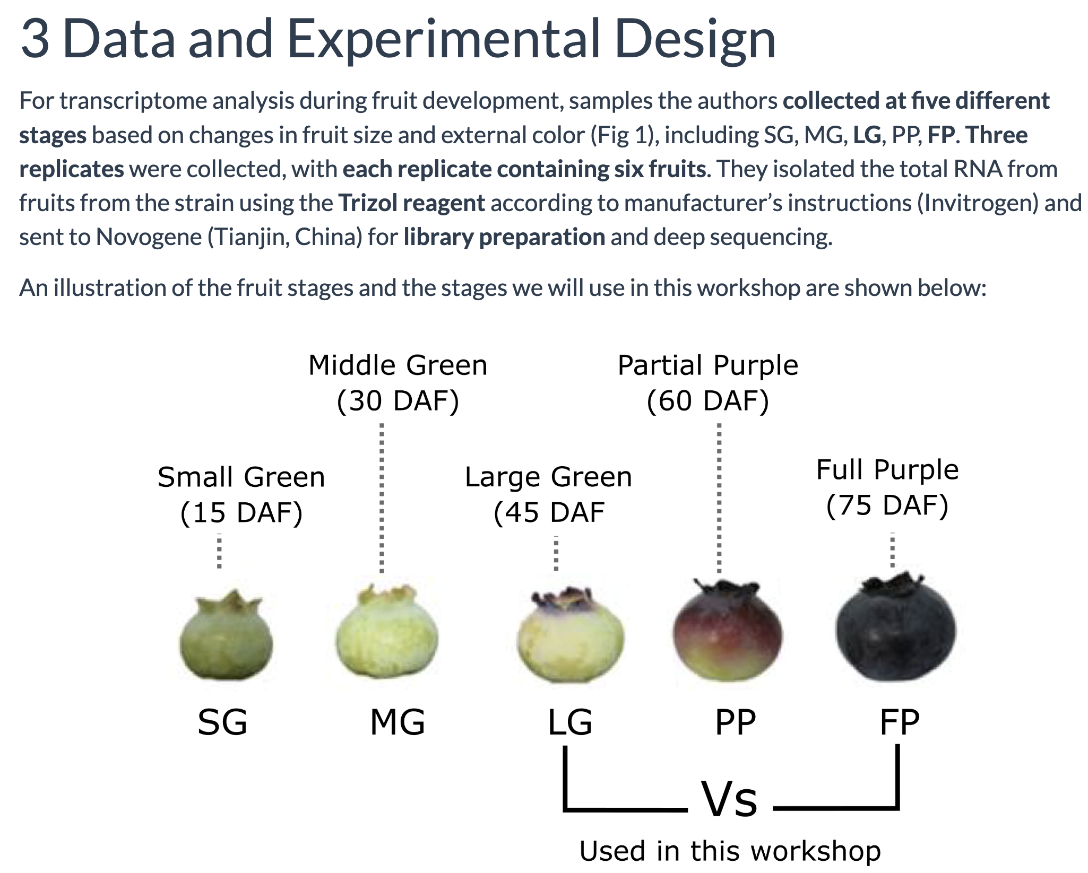

Slide 4

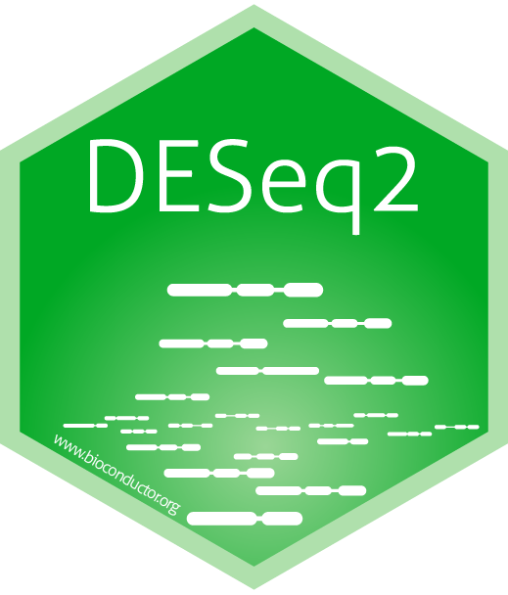

Slide 5
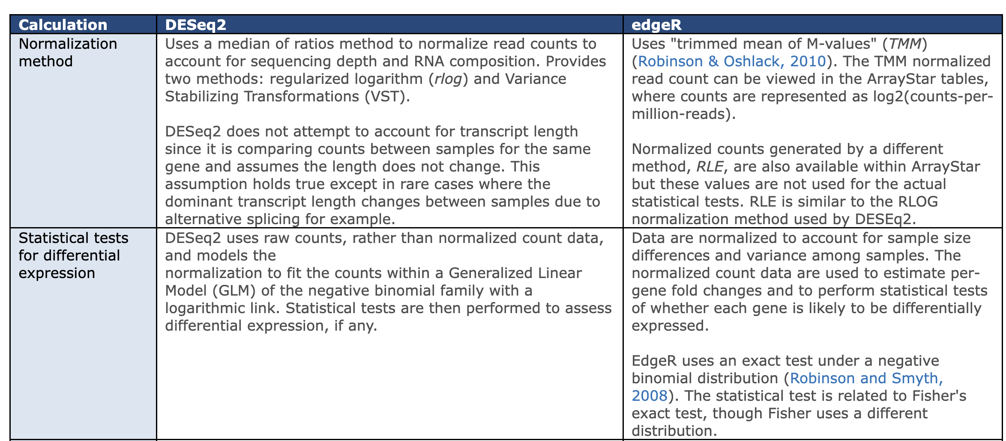

Slide 6
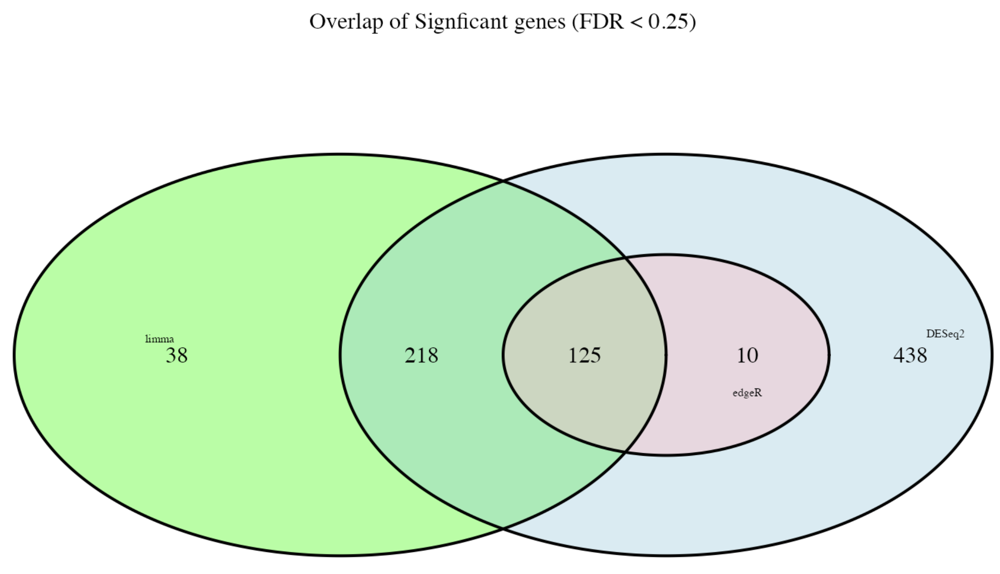
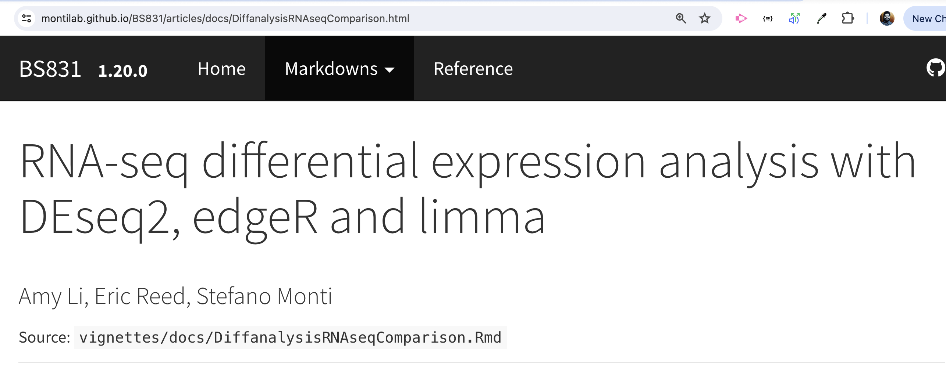

Slide 7

Explanations!

Slide 8
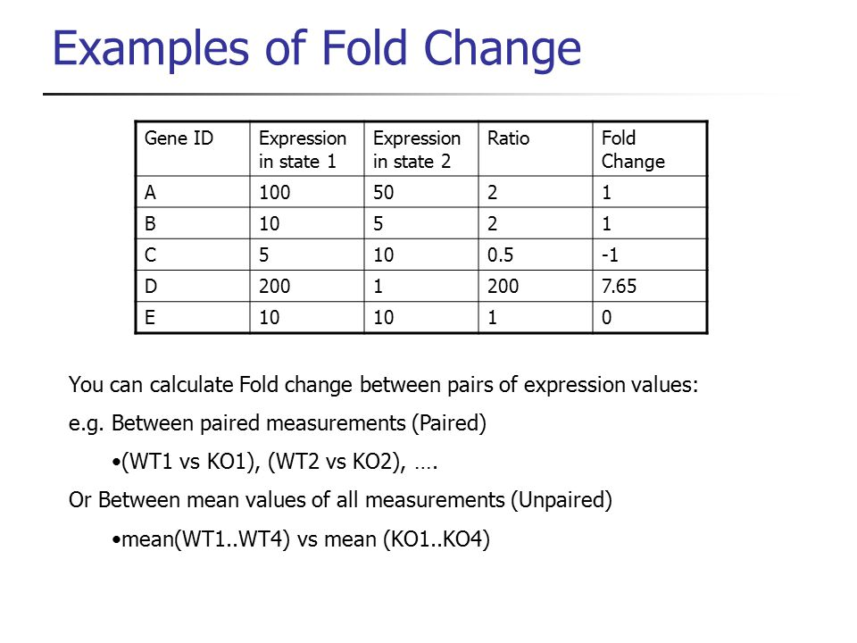
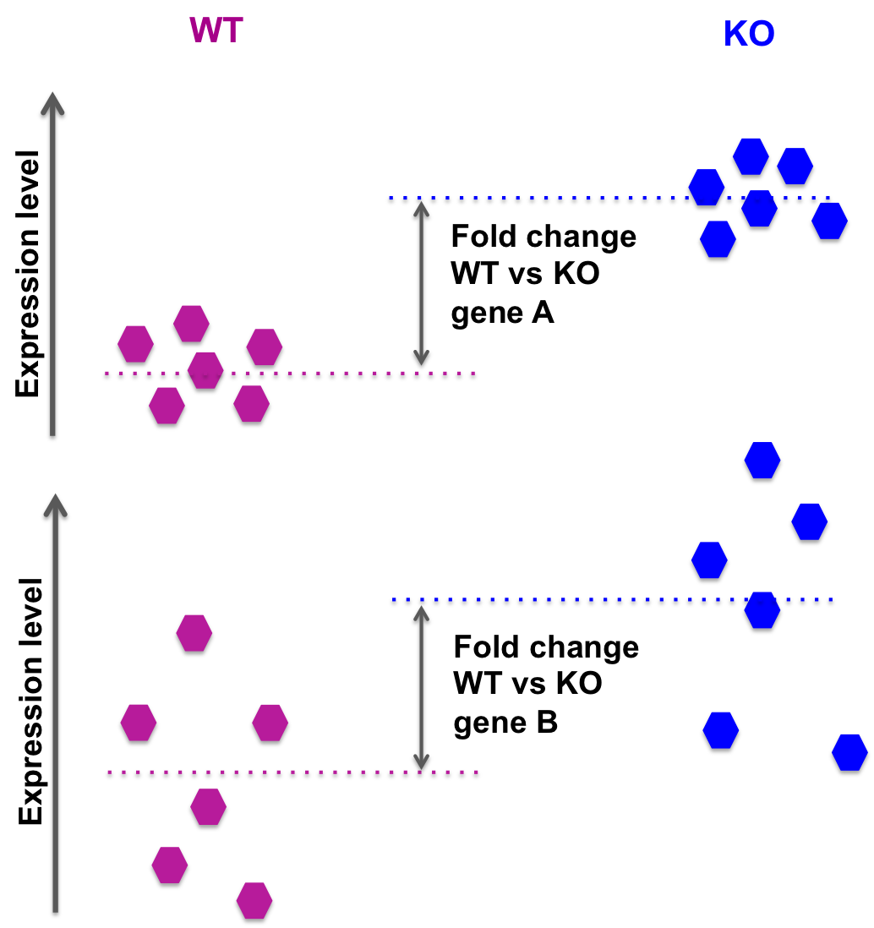
Differential Expression Analysis Using DESeq2

Slide 9
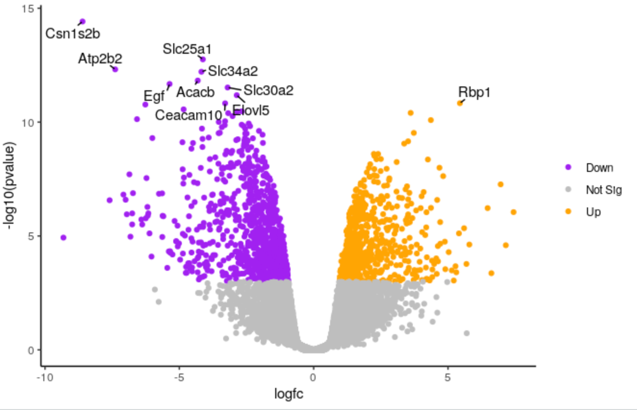
https://training.galaxyproject.org/training-material/topics/transcriptomics/tutorials/rna-seq-viz-with-volcanoplot-r/tutorial.html

Slide 10
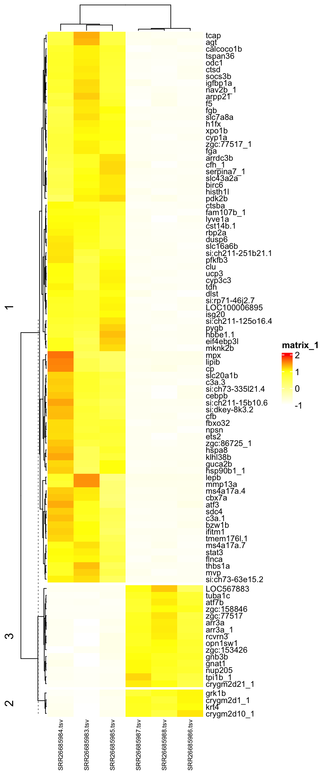
HEATMAP

Slide 11
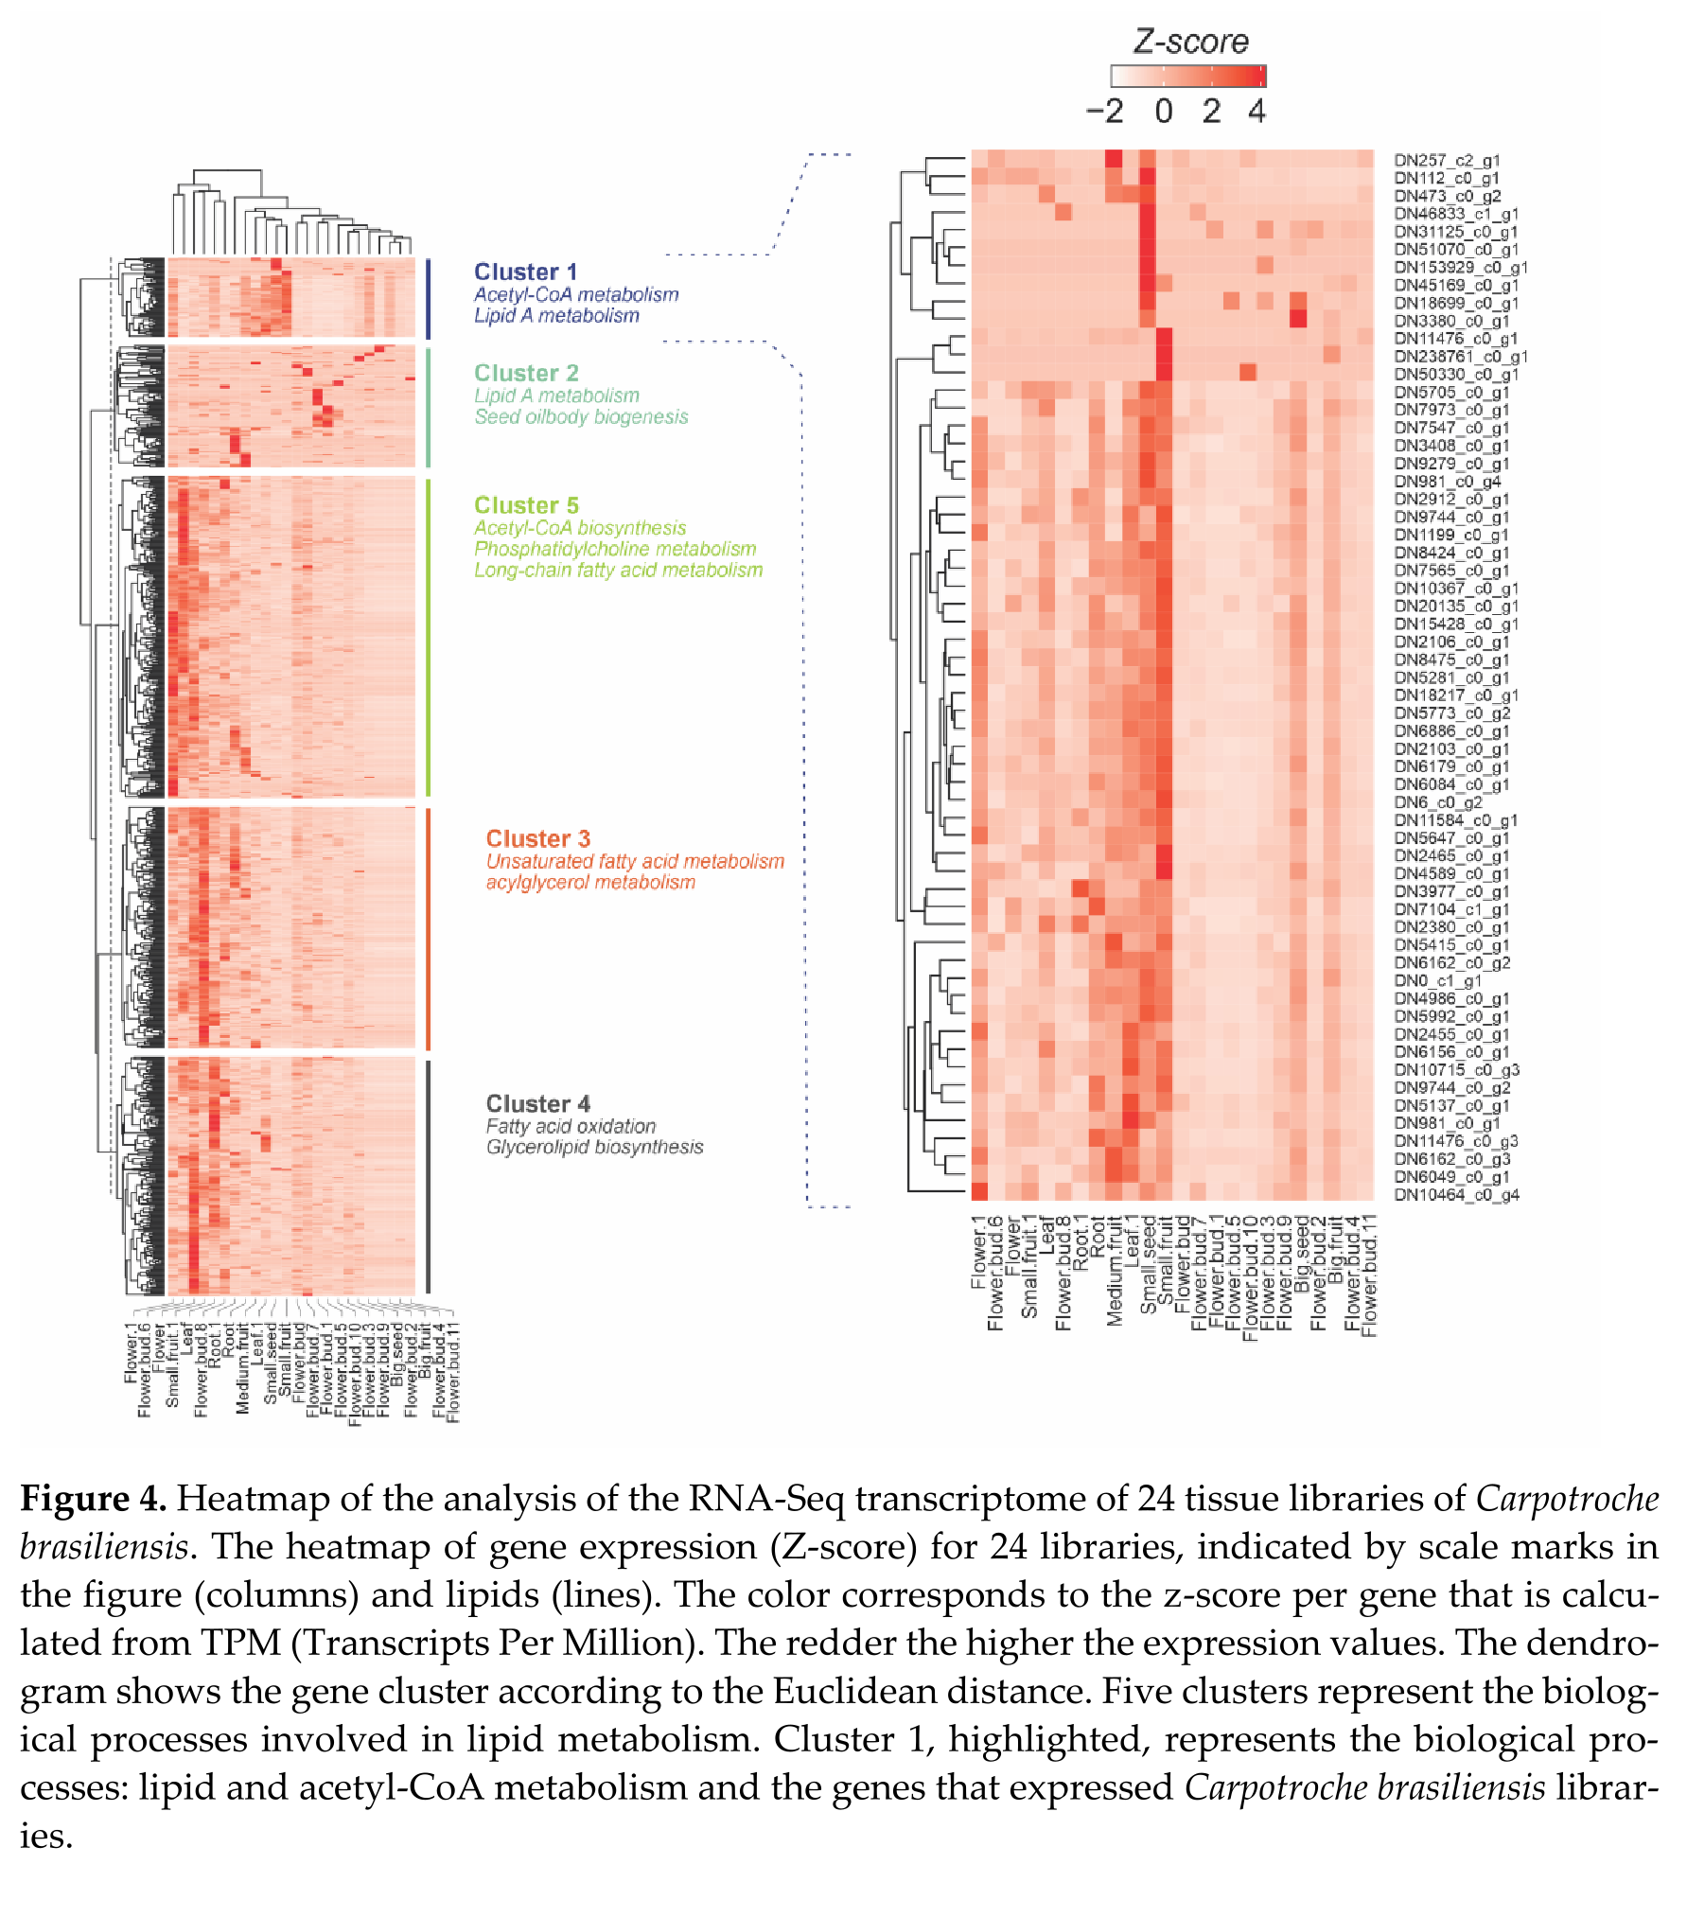
HEATMAP

Slide 12

And now, what to do with the list of DEGs?

Slide 13
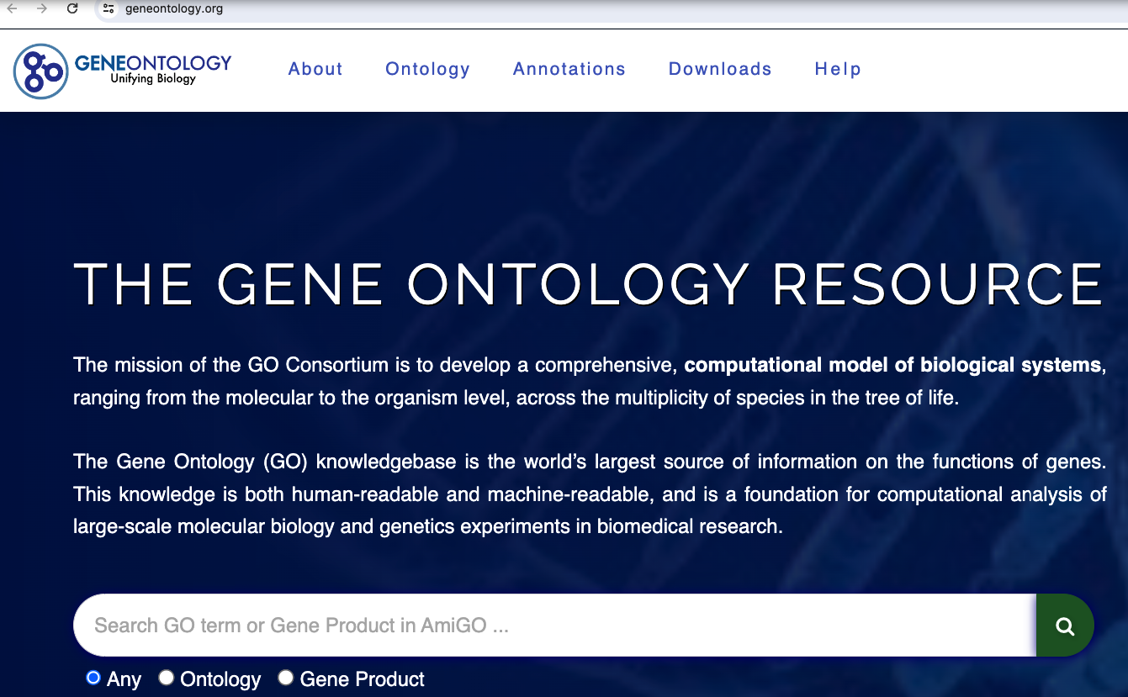
Example term
Id: GO:0000016
Name: lactase activity
Ontology: molecular_function
Def: "Catalysis of the reaction: lactose + H2O=D-glucose + D-galactose." [EC:3.2.1.108]
Synonym: "lactase-phlorizin hydrolase activity" BROAD [EC:3.2.1.108]
Synonym: "lactose galactohydrolase activity" EXACT [EC:3.2.1.108]
Xref: EC:3.2.1.108xref: MetaCyc:LACTASE-RXN
Xref: Reactome:20536
Is_a: GO:0004553 ! hydrolase activity, hydrolyzing O-glycosyl compounds
The ontology covers three domains:
Cellular component, the parts of a cell or its extracellular environment
Molecular function, the elemental activities of a gene product at the molecular level, such as binding or catalysis;
Biological process, operations or sets of molecular events with a defined beginning and end, pertinent to the functioning of integrated living units: cells, tissues, organs, and organisms.
The Gene Ontology (GO) is a major bioinformatics initiative to unify the representation of gene and gene product attributes across all species.
maintain and develop its controlled vocabulary of gene
annotate genes and gene products, and assimilate
provide tools for easy access to all aspects of the data provided by the project

Slide 14
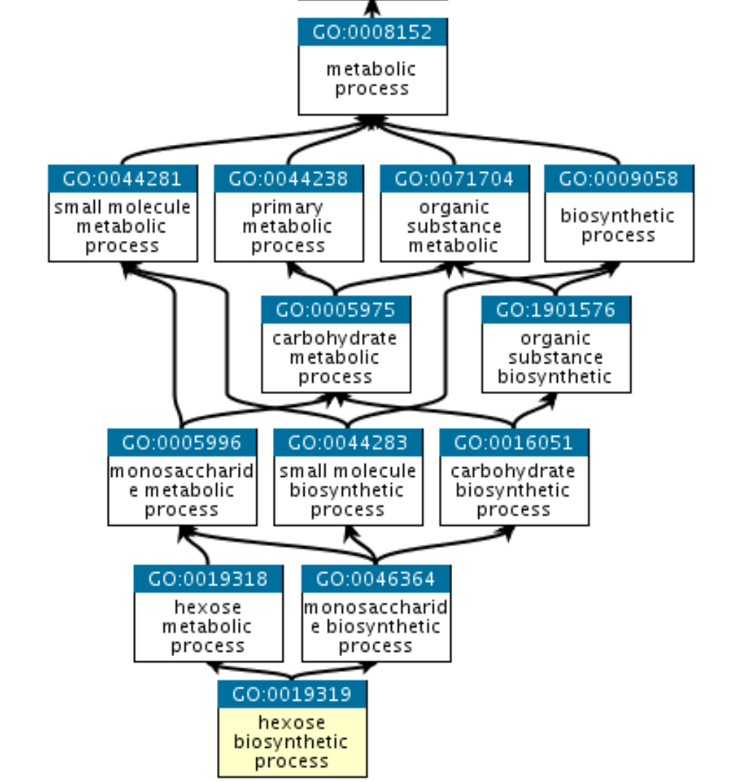

Slide 15
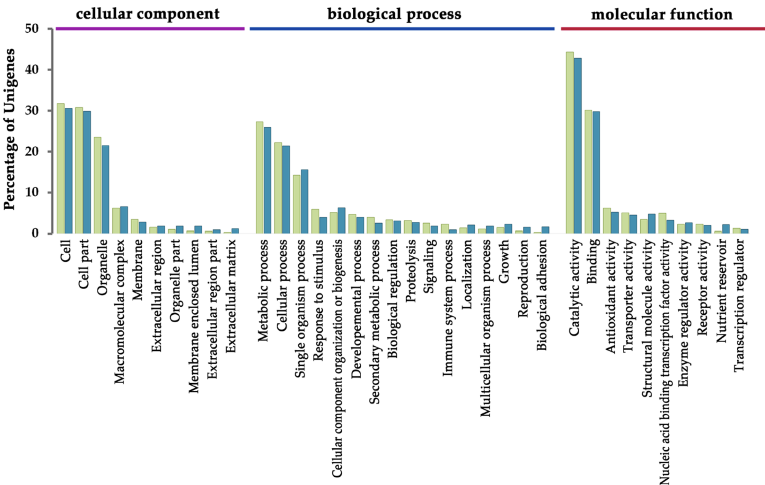
GO Analysis Categorization
https://doi.org/10.1038/s41598-019-45383-w

Slide 16
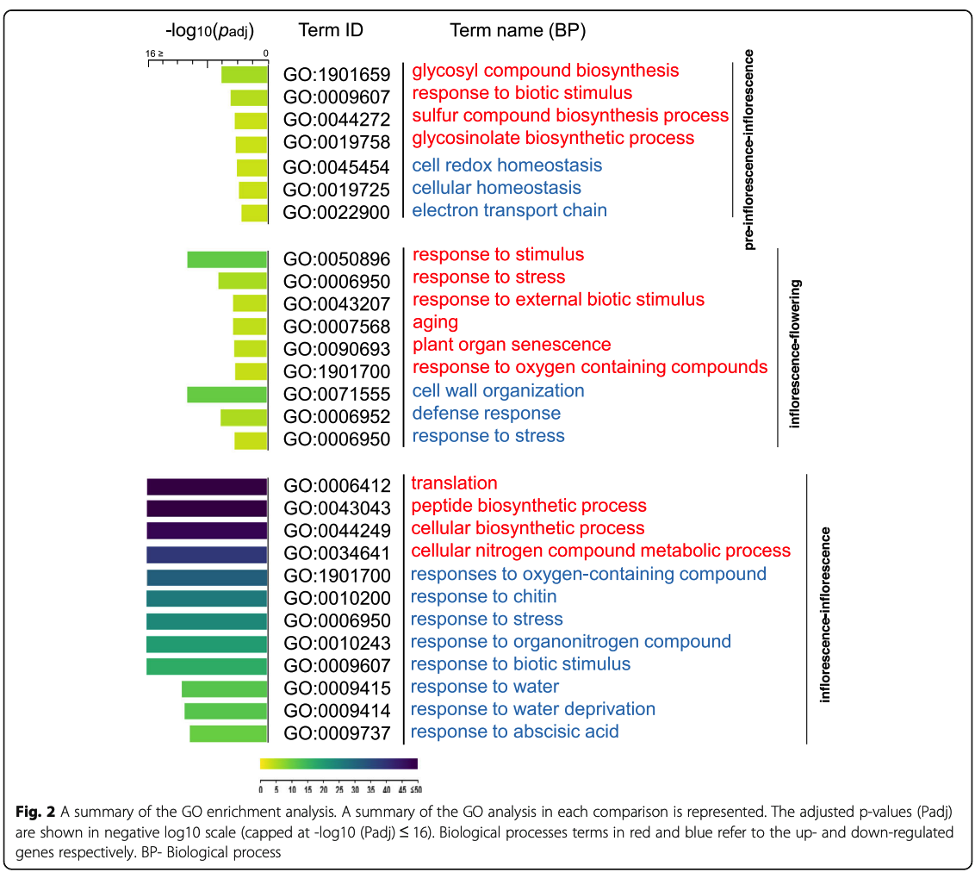
GO Enrichment Analysis
https://doi.org/10.1186/s12870-020-02418-z

Slide 17
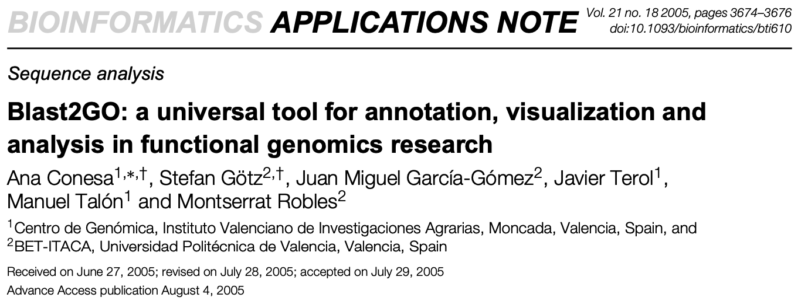
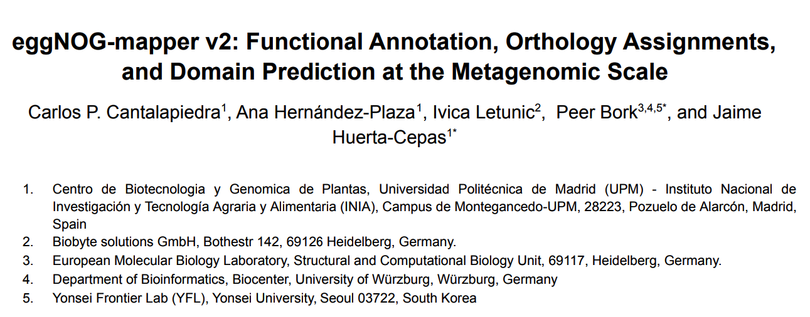
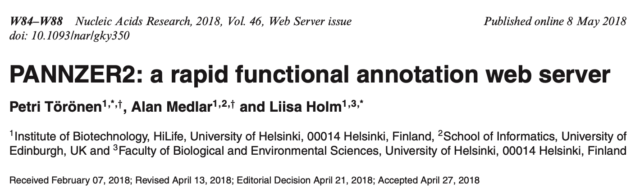
HOW TO OBTAIN FUNCTIONAL ANNOTATION?

Slide 18
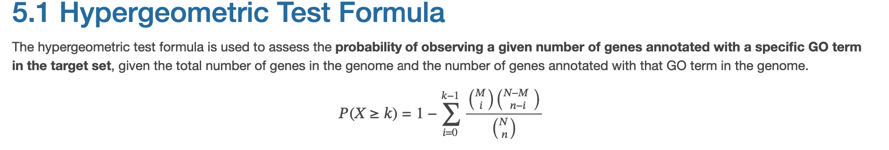
Functional Enrichment Analysis
Where:
- N is the total number of genes in the background set (e.g., the whole genome).
- M is the total number of genes annotated with the GO term in the background set.
- n is the number of genes in the target set (e.g., differentially expressed genes).
- k is the number of genes annotated with the GO term in the target set.

Slide 19

PRACTICE

Slide 20

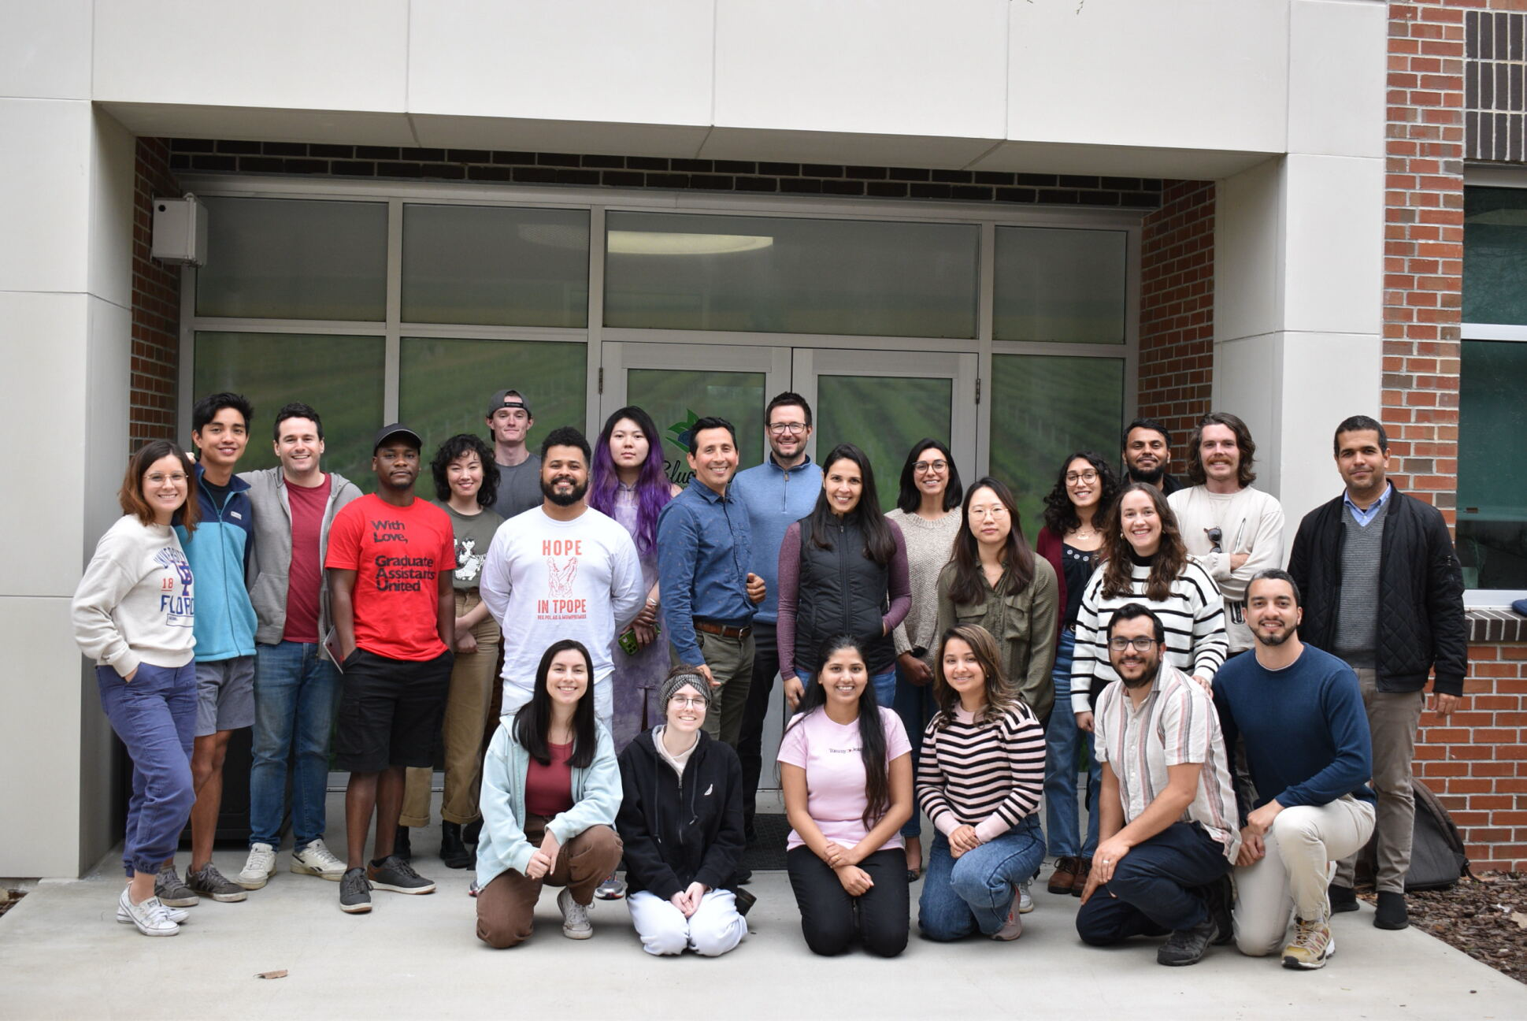



Thank you!
Dr. Patricio Munoz
Dr. Kelly Balmant
Dr. Seonghee Lee
Dr. Brad Barbazuk
Dr. Juliana Benevenuto
Questions?

